Slide 1
CIS - Bannari Amman Institute of Technology
By:
CyberHawks

Slide 2
FUNCTIONAL DESCRIPTION
Registration is offered. Then the registered user logs in to our site.
Those who can provide health care can provide it and vice-versa.
HealthTech will be a Web application to help people with their medicine and doctors’ routine. It will store ,the medical prescription given in the hospital , at the server and maintain untill it is needed.
It helps the people about the intake of medicine, nearest chemist shop and also for the doctor's appointment.
HealthTechie will be a Personal Medical Chatbot to assist the patients.

Slide 3
AIM OF THE PROJECT
Helping people who are poor, providing healthcare and free online healthcare in this covid-19 scenario
Aesthetic user interface, providing all as a service

Slide 4
FEASIBILITY STUDY
Technical feasibility
This project is a completely web-based application.
The main technologies and tools associated with this project are HTML, CSS, etc.
Each of them is freely available and the technical skills required are manageable.
Time limitations of product development and ease of implementing using these technologies are synchronised.
From this, it is clear that our project is technically feasible

Slide 5
FEASIBILITY STUDY
Resource feasibility
Resources required for this project includes,
Programming device (laptop/PC)
Programming tools (freely available)
Hosting space (freely available)
Programming individuals
From these, it’s clear that this project has required resource feasibility

Slide 6
FEASIBILITY STUDY
Social/Legal feasibility
This project uses freely available development tools and provides system as an open source system
Software libraries used in this system are free open source libraries

Slide 7
SOFTWARES USED
Microsoft VS Code
It is a free source code editor made by Microsoft. Features include support for debugging, syntax highlighting, intelligent code completion, snippets, code refactoring and embedded Git.
Users can change keyboard shortcuts, themes, preferences, install extensions that add additional functionality.

Slide 8
SOFTWARES USED
MySQL
MySQL is an open-source relational database management system
A relational database organizes data into tables in which data types may be related to each other. These relations help structure the data.
Firebase also used.

Slide 9
UML DIAGRAMS
UML stands for Unified Modeling Language.
It is a consistent, general purpose, modeling language in the area of object oriented programming and software engineering.
The main objective of UML diagrams is to visually represent a system for better understanding
The Next diagram represents the USE CASE:

Slide 10
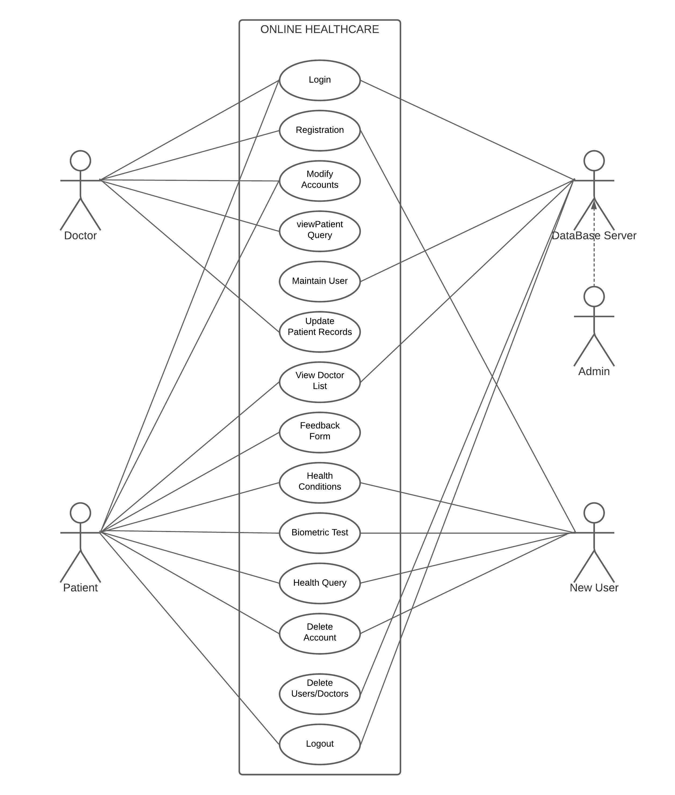

Slide 11
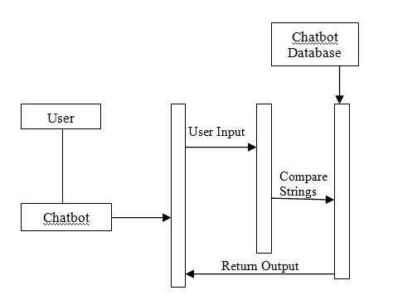
Sequence Diagram (For the Medical Chatbot)

Slide 12
CONCLUSION
The purpose and objective Healthtech Website Project will be achieved .By providing extremely rich graphical user interface, Flexibility in storing , maintaining and assist the users .

Slide 13


